Slide 1
Guardian Angel
SDV Hackathon 2023 / „Hack the car“ challenge
Munich, November 2023

Slide 2
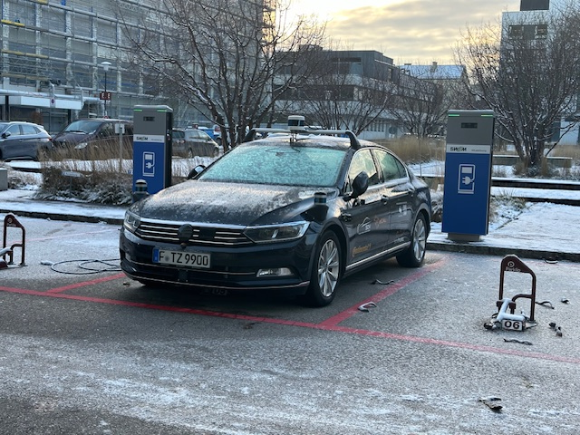
Hackathon challenge
The goal of the challenge is to use the demonstrator car interfaces in combination with the eCAL middleware to develop a software to cover a scenario.

Slide 3
Situation
Increasing number of the traffic participants leads to
More data to capture
More conditions to check
Less time to react
Traffic participants:
Moving vehicle
Pedestrian
Infrastructure
Tasks
Capture environment
Make decisions
Prevent traffic accidences using
Acoustic and optic signals to warn other participants
Own action

Slide 4
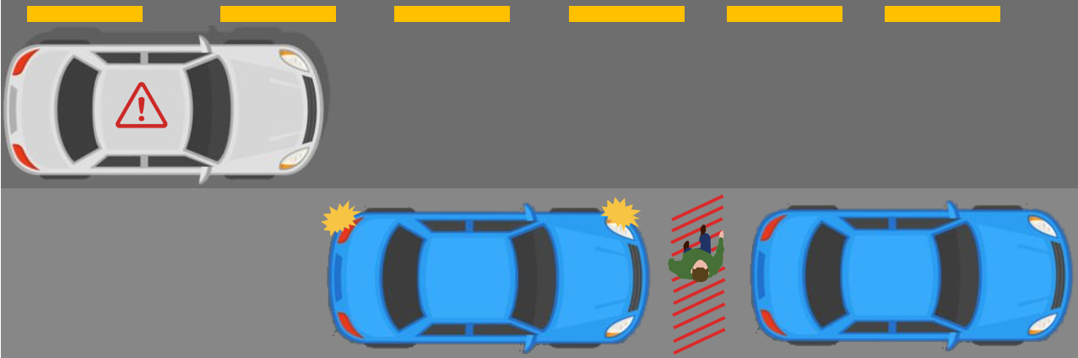
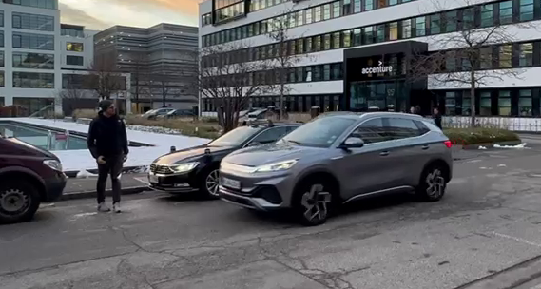
Covered scenario
Our car is parked on the street shoulder
An other car passed same street
A pedestrian is about to across
If there is a risk of an accident occurring
Raise a warning

Slide 5




Approach
Extend the participant circle by introducing the third role Parked Car
Using sensor array of the parked car to capture the environment to cover areas the other two don’t get yet
Detect potential dangerous situation
Using parked car signal capabilities to warn both other participants
5

Slide 6

Realization

Slide 7
Realization
Our primary focus in the realization of this tool is to implement the logic for detecting relevant objects and triggering a warning system in case of potential danger situations.
Both the sensor data and the warning system are provided by the given car over a high-level abstraction layer.
Car data
Guardian
Angel
Warning
RemoteVehicle
eCAL CarGateway
Coordinate Transformer
Detector
GuardianAngel
eCAL CarGateway

Slide 8

Demonstration

Slide 9
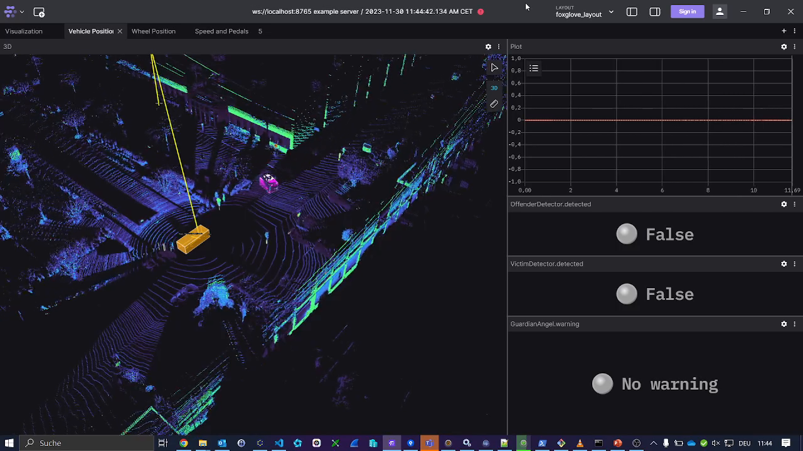
Insert Heading

Slide 10
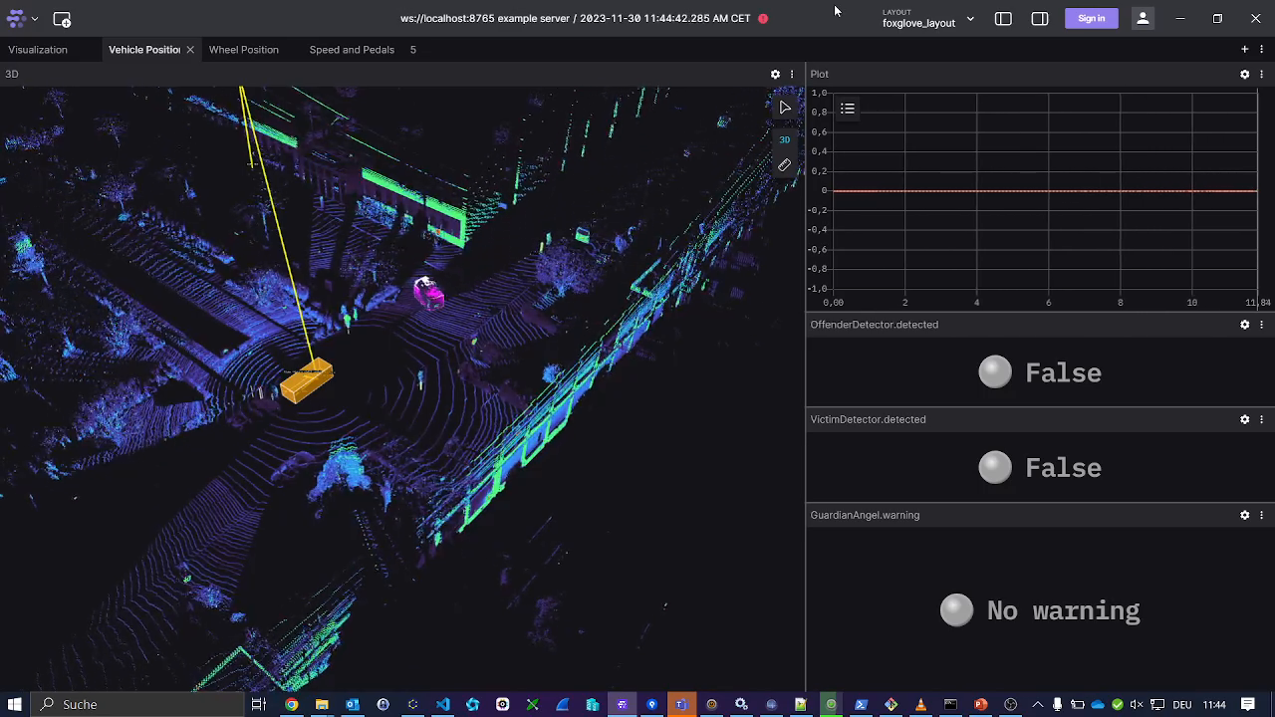
Insert Heading

Slide 11
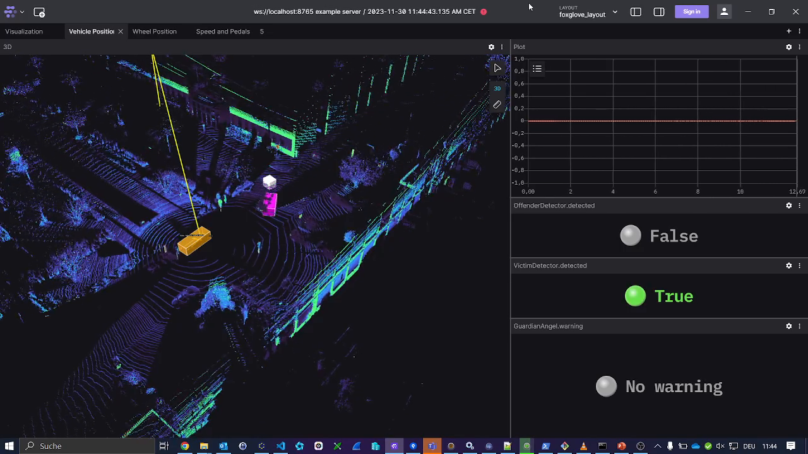
Insert Heading

Slide 12

Insert Heading

Slide 13
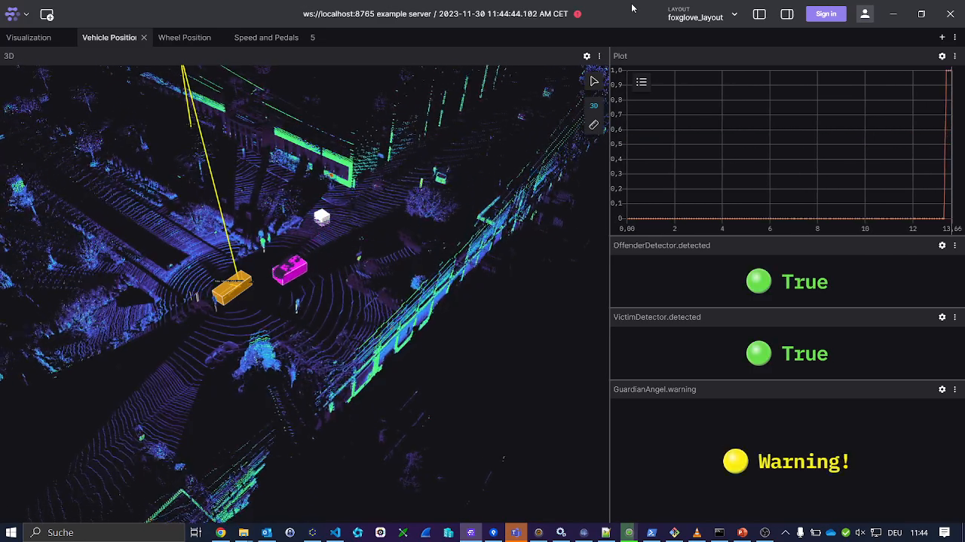
Insert Heading

Slide 14
Business case

Slide 15










Slide 16
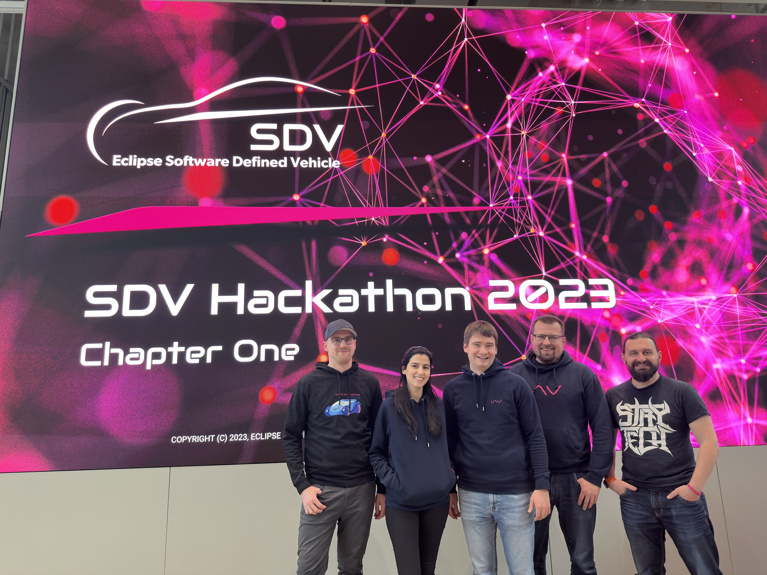
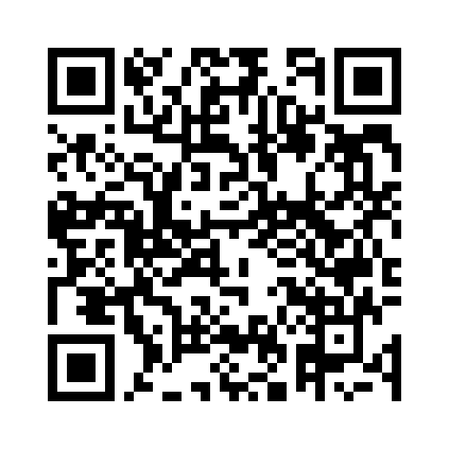
Contact
Many Thanks!

Slide 17
Control Information
Project: |  | Here are the Title/Theme of the project/offer, incl. the project or offer number (if available)
Version: |  | 0.0.1
Status: |  | draft / released / not valid
Confidentiality: |  | public / internal / confidential / strictly confidential
 | Date | Name |  | Dept. | Phone
Created: | DD.MM.YYYY | Title First Name Last Name |  | XX-XXX | +49 XXXX XX-XXXXX
Reviewed:
Released:
Change History
Version | Date | Name | Changes
 | DD.MM.YYYY | Title First Name Last Name

Slide 18

Premise Every humans life and health should be protected

Slide 19
Situation

Slide 20
Insert Heading

Slide 22


